Slide 1
Nurturing Whole Health in the Healthcare System
Integrative Health Training through Diverse Educational Modalities

Slide 2
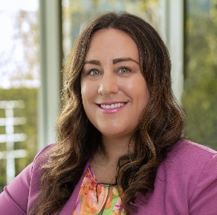

Presenters
Katrina Vigo
MSN, RNC-MNN, HNB-BC
Senior Nurse Clinician
Transformative Educational Strategies: Building the Lerner Holistic Integrative Health Nursing Fellowship
Shari Esquenazi-Karonika
PhD, MPH, MS
Senior Program Director,
Healthy Mondays for Hospitals
Healthy Mondays for Hospitals: Hands-On Learning Opportunities for Students Supporting the Development of Health Promotion Programming for the Hospital Ecosystem

Slide 3
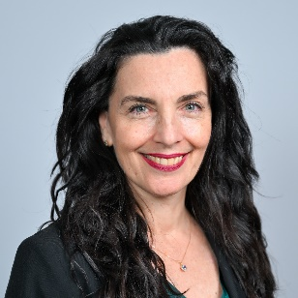
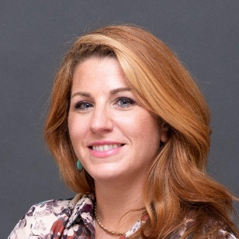
Presenters (continued)
Michelle J. Bombacie
MS Dipl. Ac. (NCCAOM) L.Ac., L.M.T.
Program Manager,
Integrative Therapies Program
Integrative Health In Employee Wellness: Healthy Monday Initiative, Resident Education in Sleep Techniques, and Lerner Scholar Fellowship
Darah K. Salmaggi
MS
Program Manager,
Department of Integrative Health, Lerner Health Promotion
Branches of Wellness: Approaches for Cultivating Integrative Wellness Champions throughout the Hospital Community

Slide 4
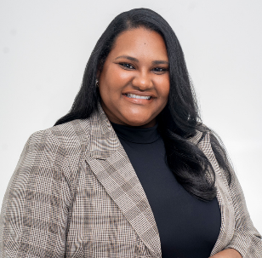
Presenters (continued)
Fariza Alendy
MSW, MPH
Program Director –
Health Promotion
Pathways for Every Learner: Development of Integrative Health Education Opportunities Ranging from High School to Professionals

Slide 5
Thank you to Helaine and the late Sid Lerner for their generous financial support for these programs.

Slide 6

Transformative Educational Strategies: Building the Lerner Holistic Integrative Health Nursing Fellowship
Katrina Vigo, MSN, RNC-MNN, HNB-BC
March 2025

Slide 7
Disclosures
None of the speakers for this activity have relevant financial relationships to disclose with ineligible companies.

Slide 8
Background
    The Veterans Health Association's (VHA) strategic plan states that focusing on overall wellbeing is a core responsibility of the healthcare system and requires planning, action, and evaluation along with a system wide recognition on this focus for both patients and staff (Kliger, et. Al, 2022).
    Since 2005, there has been an increase in utilization of complementary and integrative health approaches to promote resilience, improve clinical care, restore health, and prevent disease in patients (Pitcher et.al, 2023)
    A synthesis of 95 studies (Dall'Ora et al., 2020) suggest mindfulness, meditation strategies, collaborative co-worker relationships, and educational programs to increase confidence in nursing skills as strategies for addressing nursing burnout.

Slide 9
Background
In a 2023 survey of registered nurses at NYULH (n=10):
(40%) stated they "rarely" utilize integrative health or holistic nursing skills in their professional practice​
(100%) rated it “important” or “very important” to incorporate holistic or integrative practices into professional and personal practices.
Category | Percentage Rated "Very Good" or "Excellent "
Skill/knowledge in holistic nursing | 0%
Skill/knowledge in integrative health | 10%
Skill in designing and implementing QI or research | 20%
Knowledge in designing and implementing QI or research | 30%

Slide 10
Problem
How do we:
      Integrate holistic nursing, integrative health, and Whole Health practices to support nursing wellbeing, professional development, and patient care?
      Cultivate skills in implementing sustainable quality improvement initiatives to promote system wide wellbeing for patients, caregivers, and staff?
      As of 2023, no nursing programs or fellowships exist that provide practice implementation with an emphasis on well-being, professional development, system-wide quality improvement initiatives and mentorship in holistic nursing and integrative health.

Slide 11

About the Lerner Holistic Integrative Health Nursing Fellowship
9-month, 172-hour program
Diverse curriculum encompassing American Nurses Credentialing Corporation (ANCC) approved courses
Blended live, virtual, and self-paced learning
Immersive Clinical Experiences
Professional Mentorship and Networking
Wellness and Reflective Practices
Holistic Skill Development
Innovative Quality Improvement and Care Models
Lerner Health Promotion Program /Department of Integrative Health​

Slide 12
Curriculum
Module 1 | The Foundations: Holistic Nursing, Integrative Health, and Mind-Body Connection
Module 2 | Holistic Solutions: Mastering Project Management, Quality Improvement, and Research
Module 3 | Integrative Approaches: Enhancing Care, Communication, and Therapeutic Environments
Module 4 | From Vision to Reality: Implementing Wellness Projects in Practice
Module 5 | Integrative Healing: Trauma-Informed Care and Mind-Body Medicine
Module 6 | Empower & Thrive: Self-Care and Resiliency Strategies
Module 7 | Integrative Approaches to Holistic Nursing: Holistic Modalities I
Module 8 | Integrative Approaches to Holistic Nursing: Holistic Modalities II
Module 9 | Holistic Horizons: Professional Development and Beyond

Slide 13
Outcomes
Quality Improvement Initiatives
SPARK: Supporting Nurses’ Professional And Reflective Knowledge | Prepare for Surgery, Heal Faster (PFS) and Effectiveness in Patients Undergoing Head and Neck Surgery
Standardizing Bereavement Care to Support Outpatient Oncology Nurses | Promoting Mindful Breathing for Anxiety and Stress Reduction Among Surgical Patients and Staff
Utilizing Mindfulness Techniques During Kangaroo Care to Support Parental Stress Reduction | Escape to Work: Wellness Initiatives in the Office
Implementation of Monthly Staff Meetings and Employee Rounding to Impact Domains of Wellbeing and Resiliency in the Workplace | Accessibility of Reiki for Families of Patients Undergoing Surgery
Impact of Pre-Shift Mindful Breathing Huddles on Staff Well-Being | Utilizing Wellness Modalities for Caregivers of Surgical Patients

Slide 14
Overall Impact
100%
of fellows reported they use IH or holistic nursing skills in their professional practice always or often after the fellowship
240
Healthcare Professionals
18%
453
Patients and Caregivers
of fellows reported they use IH or holistic nursing skills in their professional practice always or often before the fellowship
in their 3-month pilot phases
Lerner Health Promotion Program /Department of Integrative Health​

Slide 15
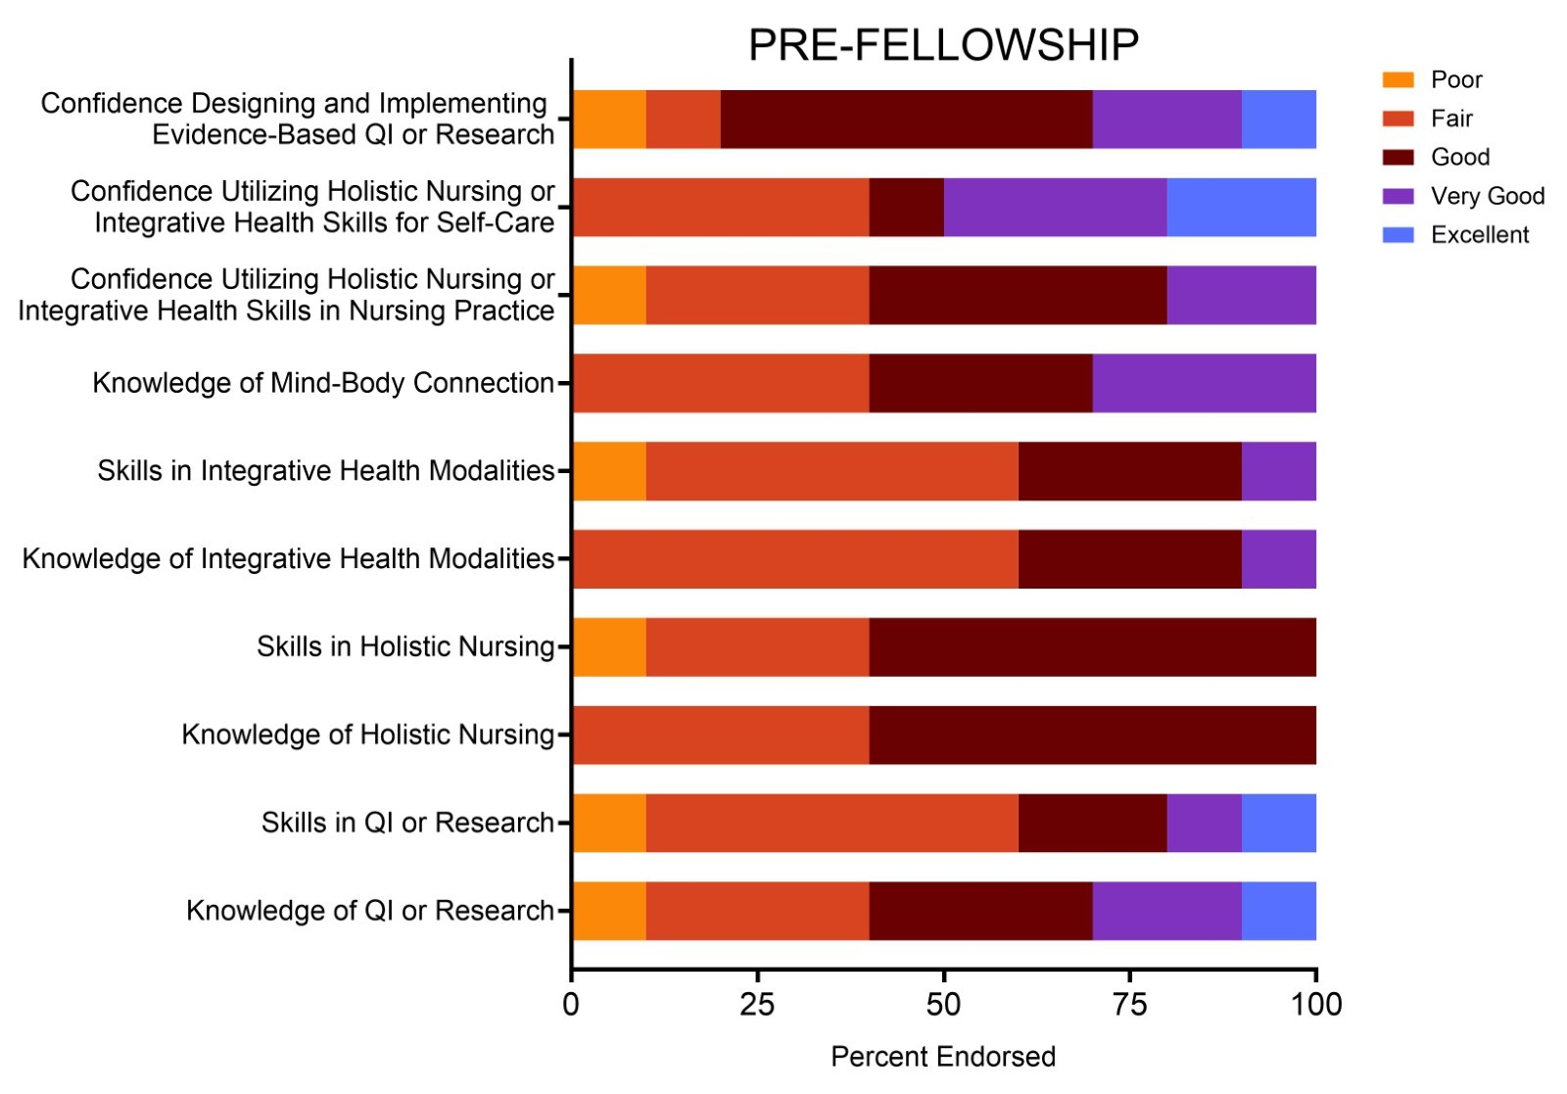
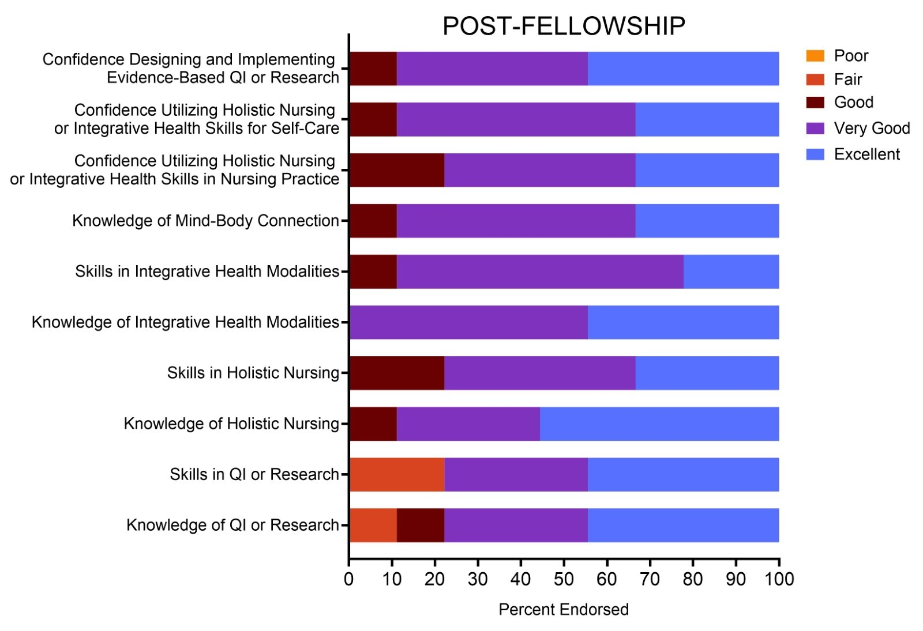
Outcomes

Slide 16
Key Educational Themes
Integration of holistic and IH practices
Mind-body and mindfulness techniques
Self-care, wellness, and emotional awareness
Research and project management skills
Professional development
Resilience and mental health
Self-compassion
Trauma-informed and patient-centered care
Empowerment and advocacy skills

Slide 17
Outcomes
"helped me develop the skills I needed to improve my well-being as well as the well-being of my patients & coworkers"
Fellows said the fellowship:
“truly changed my life for the better”
“had a tremendous positive impact on my self-care and patient-care"
“helped me learn how to more systematically apply holistic modalities within a large institution”,
“changed my life both personally and professionally”
"is necessary for staff retention"

Slide 18
Opportunities
Opportunity | Action
Improve digital learning platform | Utilization of Brightspace
Additional time for:​ Collaborative Learning and Brainstorming​ Project Feedback and Support | Addition of group mentor sessions vs. individual sessions with reflective group sharing Addition of 1 in-person workshop and virtual community check-in Promotion of group-based projects
Additional time for skills development | Skills workshop developed and integrated into Immersive Day Option for Immersive Day elective
Additional support for scholarly dissemination | Addition of workshop including abstract writing, manuscript tips, resume development, poster development, authorship
Lerner Health Promotion Program /Department of Integrative Health​

Slide 19

Next Steps
Measure retention, certifications/promotions, and wellbeing 1 year post fellowship
Receive recognition as an American Holistic Nurses Association (AHNA) Endorsed Program
Offer fellowship opportunity to RNs nationwide
Continue to focus on collaborative relationship building to expand innovative care models
Manuscript Lerner Holistic Integrative Health Nursing Fellowship: A Whole Health Approach to Education and Practice submitted to the Journal of Holistic Nursing

Slide 20
Implications for Practice
Components that were central to the fellowship's success were:
      the focus on self-care
      mentorship, and
      collaborative relationships
    Potential challenges and limitations to implementation of this program in other institutions:
        The full -time role of the fellowship coordinator
        Financial support for dedicated participation time
        A need for faculty, guest speakers, and mentors with clinical expertise in holistic nursing, IH, quality improvement, and research.

Slide 21
References
Dall'Ora, C., Ball, J., Reinius, M., & Griffiths, P. (2020). Burnout in nursing: a theoretical review. Human Resources for Health, 18(1), 41. https://doi.org/10.1186/s12960-020-00469-9
Kligler, B., Hyde, J., Gantt, C. & Bokhour, B. (2022). The Whole Health Transformation at the Veterans Health Administration. Medical Care, 60 (5), 387-391. https://doi: 10.1097/MLR.0000000000001706
Pitcher, M. H., Edwards, E., Langevin, H. M., Rusch, H. L., & Shurtleff, D. (2023). Complementary and integrative health therapies in whole person resilience research. Stress and health : journal of the International Society for the Investigation of Stress, 39(S1), 55–61. https://doi.org/10.4103/jehp.jehp_1090_22

Slide 22
Our Gratitude
To the Lerner family for their continued financial support for this program including 172 hours of paid, protected time for NYULH RN's.

Slide 23

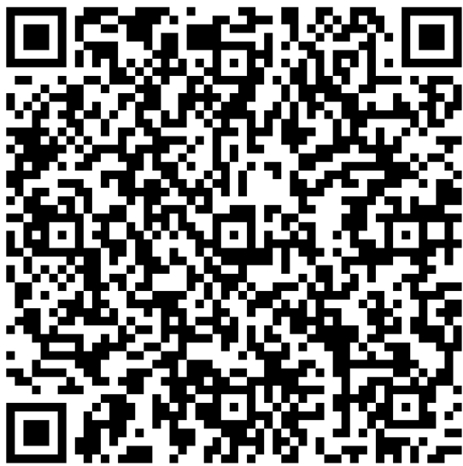
Q&A

Slide 24
Thank You
Katrina Vigo, MSN, RNC-MNN, HNB-BC
Katrina.Vigo@nyulangone.org
LernerFellowshipProgram@nyulangone.org

Slide 25

Healthy Mondays for Hospitals: Hands-On Learning Opportunities for Students Supporting the Development of Health Promotion Programming for the Hospital Ecosystem
Shari Esquenazi-Karonika, PhD, MPH, MS
3/5/2025

Slide 26
Overview
Healthy Mondays for Hospitals (HMH)
HMH Summer Internship
Collaboration with Public Health Experts & Students
Opportunities for Practical Experience Requirements
Leveraging Doctoral-Level Students and Graduates

Slide 27

Healthy Mondays for Hospitals
Developed by marketing industry executive & public health advocate, Sid Lerner
Local, national, and global-level initiatives to help end preventable diseases
Leverages Monday as a “fresh start” each week
Provides 52 chances to get back on track
Healthy Mondays for Hospitals brings this whole person, holistic, and evidence-based programming to patients, caregivers, and healthcare workers

Slide 28
HMH Summer Internship
Teamwork makes the dream work
For small teams, recruiting energetic and driven interns can provide support for various tasks and projects
Universities have a surplus of excited students who are craving hands-on experience in the hospital setting
Educational programs can provide course credit for students participating in internships

Slide 29
HMH Summer Internship (continued)
Snapshot of the inaugural internship cohort
We recruited 5 undergraduate-level interns (ranging from freshman to senior) after receiving over 30 applications
A total of 2 interns pursued the academic credit option and earned 4 credits each toward their 18-credit minors
Interns came on-site 1x/weekly to learn about foundational public health concepts, theories, and frameworks
They worked 15 hours per week (hybrid)
Interns worked on individual and group-level projects, and were invited to be co-authors on relevant abstracts

Slide 30
HMH Summer Internship (continued)
Summer interns helped with foundational tasks
for our new program
Developed a catalog of the robust Healthy Monday campaigns (stop by our poster tonight!)
Prepared socio-ecological models for various populations and settings within the hospital ecosystem
Carefully reviewed over 100 existing Monday programs and flagged opportunities for tailoring to our unique priority populations and settings

Slide 31
Collaborating with Public Health Experts & Students
UGPH-GU 60: Undergraduate Experiential Learning in Public Health
Capstone course for public health majors
Led by seasoned health promotion program developer & researcher
Scaffolded assignments that culminate into a full campaign and evaluation plan
Student teams are assigned and work on a specific campaign/project
  Prepare literature reviews about populations, health behavior(s), barriers,
  and facilitators
  Generate socioecological models for a given population and setting
  Follow the "Monday" format for a well-rounded health promotion program
Serves as a recruitment pipeline for the HMH summer internship

Slide 32


Collaborating with Public Health Experts & Students
(continued)
Spring 2025 Campaign Assignments
Smoking & Vaping Cessation for Oncology Patients
Whole Health for Pregnant Women
Oral Hygiene for Patients
Sleep Hygiene for Patients
Physical Activity for Healthcare Workers
Anxiety Reduction & Stress Coping
for Rehab Patients

Slide 33
Opportunities for Practical Experience Requirements
Many graduate programs have practical
or applied learning experience requirements.
    Intended to recruit talent with foundational public health training who can support special projects
    Sought to find a graduate student who needed a practical placement in exchange for academic credit
      Recruited and onboarded an MPH-level intern/volunteer who can receive 3 credits for her Integrated Learning Experience and another 3 credits for her Practicum/Thesis

Slide 34
Opportunities for Practical Experience Requirements
(continued)
Students with advanced education
and training can be assets for small teams.
    Masters-level students bring a deeper level of specialization within a field
    Able to help with all tasks that undergraduate students help with, plus:
      Support the development of evaluation plans and relevant materials (surveys, interview guides, etc.)
      Can apply knowledge to suggest novel programming and adaptations for existing programming in order to better align with the priority population and setting

Slide 35
Opportunities for Practical Experience Requirements (continued)
Mentoring is key to set students up for success.
    Small initial time investments can ensure that the student:
      Is oriented to the institutional software and tools
      Has access to necessary resources to complete tasks
      Understands assignments and feels comfortable asking clarifying questions

Slide 36
Leveraging Doctoral-Level Students & Graduates
This spring, we recruited our first doctoral student and Visiting Scholar.
    Intended to recruit talent with health promotion training and an interest in supporting HMH programming
      This position supports this year's Lerner Health Promotion Innovation Award recipients
    Circulated a description of the opportunity and targeted marketing at top public health program
    Onboarded the candidate through NYU Langone Health's NTV system

Slide 37
Leveraging Doctoral-Level Students & Graduates
(continued)
The advanced level of knowledge and skills means
that the Visiting Scholar can support:
All the tasks that undergraduate and masters-level students support, plus
    Pre- and post- intervention survey development
    Organization, analysis, and interpretation of results
    Preparation of meeting abstracts and scientific manuscripts

Slide 38
Leveraging Doctoral-Level Students & Graduates
(continued)
Considerations can be made to support a dynamic that is flexible
and mutually beneficial.
    Fully remote; meeting via Zoom and working asynchronously on collaborative working spaces (e.g., Sharepoint)
    Visting Scholar works full-time; many tasks can be completed outside of traditional hours
    The work and resulting data can be utilized for her doctoral dissertation and can translate to collaborative publications

Slide 39
Reflections
In our first year of developing these opportunities for students,
we learned a few things.
    Be strategic with recruitment
      (e.g., what field and level of student would likely be a good asset on our team/project)?
    Be resourceful— cold emails can open many doors for partnerships
    Be reasonable (with both the number of interns you recruit and the tasks you expect them to complete)
    Be mutually beneficial— unpaid internships can still be rich opportunities with sincere mentoring

Slide 40
Reflections (continued)
Some considerations:
    Umbrella organizations likely have specifications for volunteers/interns, and these processes can take time
    Preparation time needs to be dedicated to organizing the structure of the internship/opportunity, but it can be (refined and) recycled for years to come

Slide 41
Q&A

Slide 42
Shari.Esquenazi-Karonika@nyulangone.org
Senior Program Director, Healthy Mondays for Hospitals

Slide 43
Integrative Health In Employee WELLNESS:
Healthy Monday Initiative, Resident Education in Sleep Techniques,
and Lerner Scholar Fellowship
Michelle J. Bombacie, MS Dipl. Ac. (NCCAOM) L.Ac., L.M.T.
Program Manager, Integrative Therapies Program
Division of Pediatric Hematology, Oncology & Stem Cell Transplant

Slide 44
Disclosure Statement
I have nothing to disclose.

Slide 45
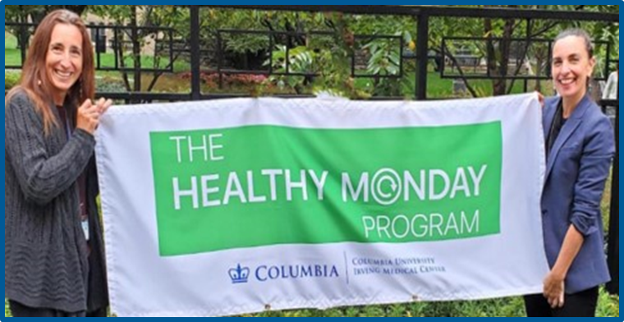
Objectives
Provide overview and timeline of 3 Healthy Monday integrative health employee wellness initiatives
Discuss the design, implementation, and evaluation of these programs, and how programming was tailored to specific populations
Utilizing the train-the-trainer model, demonstrate how education on integrative health topics combined with experiential modules promotes a culture of self-care
Discuss essential components for implementation and expansion: establishing wellness ambassadors and fostering partnerships
Share lessons learned for future programming and adaptation to other settings and populations

Slide 46
Healthy Monday Program Timeline and Demographics
Healthy Monday Employee Wellness Programs
RN: Registered Nurse
NP: Nurse Practitioner
NYP: New York Presbyterian
CU: Columbia University
SBHC: School-Based Health Center
NYU: New York University
CUSON: Columbia University School of Nursing
HR: Human Resources
CUIMC: Columbia University Irving Medical Center
CHONY: Children’s Hospital of New York
2018
2019
2020 - 2021
2022 - 2023
Group A
Group B
COVID-19 pandemic
Group C - IRB
30 participants
(Clinic RNs and NPs)
500 participants
(Clinic and Hospital Staff, Faculty, and Nursing)
20,179 participants
1225 participants
(Clinic and Hospital Staff, Faculty, and Nursing)
2023
2024
2025
Department of Pediatrics
and CUSON
REST
HR Caregiver
NYP Nursing Leadership
Pediatric Division of Hematology, Oncology, & Stem Cell Transplant
Collaboration with:
NYPBehealthy
CU Work Life
Department of Pediatrics
SBHC
12 participants
(Pediatric Residents and Fellows)
Projected 150 participants
Projected 30 participants
2024 - 2025
Lerner Scholars
CUIMC
CHONY
NYU Collaborations
Urgent self-care (6 weeks)
Integrative Health and 5 Senses (5 weeks)
CALM-PT
The HEROES Room
85 participants
(Pediatric Residents)
100 participants
(Division of Gastroenterology)
Additional Monday Campaigns Programming

Slide 47
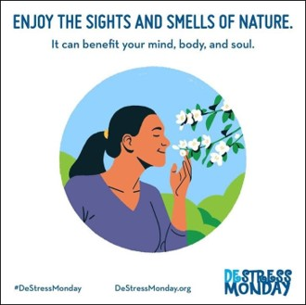
Assessment of the Healthy Monday Program:
An Employee Wellness Initiative for Healthcare Professions (HCPs)
Michelle J. Bombacie, Melanie A. Gold, Taylor B. Sewell, Pooja Vyas, Zhezhen Jin, and Elena J. Ladas
Objectives:
To systematically explore the impact of Healthy Monday Program and if weekly self-care practices could improve self-reported measures of perceive stress, burnout, self-efficacy, and importance of self-care among healthcare practitioners (HCPs).
Methods:
The evaluation of the 24-week Healthy Monday Program was part of an IRB-approved (protocol # AAAS6653) prospective cohort study.
The program delivered wellness content to approximately 1225 participants, consisting of clinical and non-clinical faculty and staff in two cohorts between September 2022 and October 2023.
Participants completed anonymous retrospective post program survey
  Demographics
  Validated Measures
    New General Self-Efficacy Scale (8-item)
    Perceived Stress Scale (4-item)
    Single-item Burnout Measure
  De novo single-item measures
    “How important do you think self-care is to your overall well-being?”
    “How likely are you to recommend this Healthy Monday program to a friend or colleague?
Notes:
Self-care– categorical variable
Recommendation-- Score range 0-10 (most likely)

Slide 48
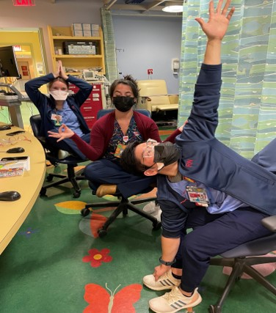
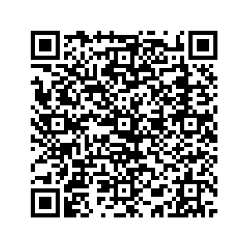
Program Content: Healthy Monday for HCPs
Program Content: Content consisted of evidence-based self-care practices, including mind-body techniques and movement and nutrition tips, that were delivered via email every Monday.
Week 1 - 12 introduces healthy practices at a level to someone who is new to a lifestyle change
  CUIMC/NYP expert videos (10 - 20 minutes in length)
  Examples of Video Topics: Setting Intentions, Positive Emotions, Managing Anger, Dealing with Burnout, Emotional Freedom Technique (EFT) Tapping for Discomfort, Self-Massage, Dancing, Chair Yoga, Mindful Eating
Week 13 – 24 is structured with the understanding that participants have built a foundation of self-care knowledge and possibly a regular Monday routine
Additional resources included from CU Work | Life and NYPBehealthy
QR code to Program’s video library

Slide 49
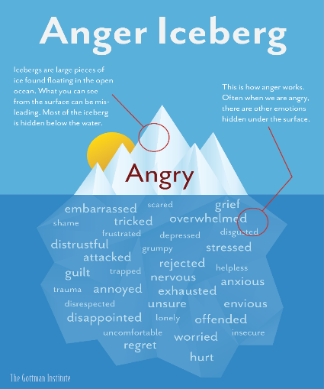
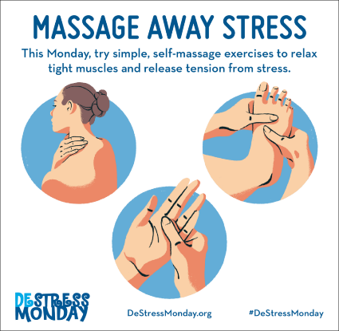
Results: Healthy Monday for HCPs
Demographics
50% clinical, 50% non-clinical roles
Mid-age participants
<25 years in healthcare role
Majority female and non-Hispanic
50% white
Results
99 participants completed the post-program retrospective survey—67 answered at least one question and 46 answered demographic questions
Perceived stress and importance of self-care to well-being were found to be statistically significant self-reported benefits
  Mean score for perceived stress: 1.61 to 1.48 (range: 0 – 4)
  Importance of self-care to well-being: percentage after program was completed is higher for ‘extremely’ category (33.3% to 48.9%)
Participants rated their likelihood to recommend the program to a friend or colleague at an average score of 6.02 (range: 0 – 10)
Engagement
Web page visits: 3,444
Video views: 438
Notes:
Importance of self-care to well-being, the percentages after the program was completed is higher for ‘extremely’ category and 0 for ‘not at all’ category compared to the percentages before the program was initiated.
Burnout, the percentages after the program was completed have less participants reporting being ‘completely burned out’ and ‘burnout’, but more participants reporting being ‘under stress’ and ‘symptoms of burnout won’t go away’ as compared to before the program was initiated.
Kappa coefficients measure intra-rater reliability. Both kappa coefficients are indicative that there is substantial agreement between the participants’ responses before and after the program.

Slide 50
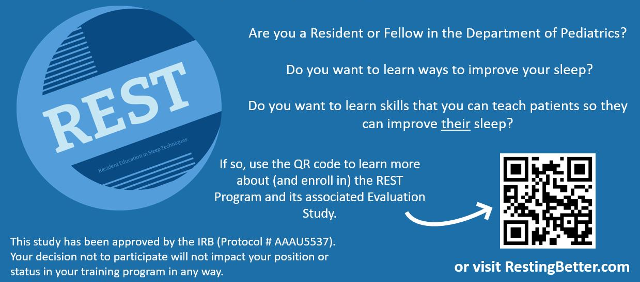
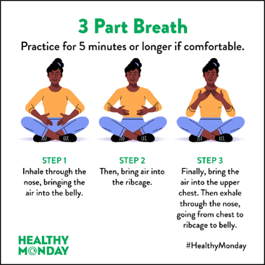
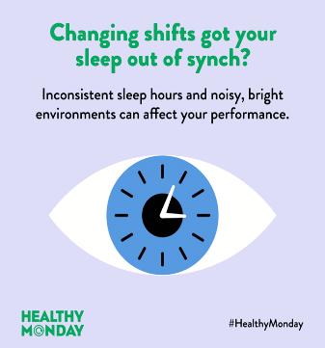
Resident Education in Sleep Techniques (REST) Program
~Developed in response to the Pediatric Resident Well-Being Committee’s request for more in-depth training on integrative therapies for self-care around sleep
Objectives
To characterize the implementation of the REST Program, including participants’ engagement with different components over the 12-week period:
  Participation rates (e.g., % of those invited who engaged with at least one element of the program
  Characteristic of participants’ (e.g., years in training, gender, race/ethnicity)
  Engagement with program elements, including: Sleep tips, Videos on integrative sleep practices, and Patient resources
Methods
Recruitment, Enrollment, and Pre & Post Program Survey
  2 Emails - linking to enrollment and pre-program survey
  Flyers and Power Point Slide with QR code displayed in Resident locations
  Perceived Stress Scale Short Form (4-items)
  PROMIS Sleep-Related Impairment Scale (8-items)
  Single-item Burnout Measure
Rachel M. Groth, Michelle J. Bombacie, Taylor B. Sewell, Samantha Garbers, Marina Catallozzi, Elena J. Ladas, and Melanie A. Gold

Slide 51
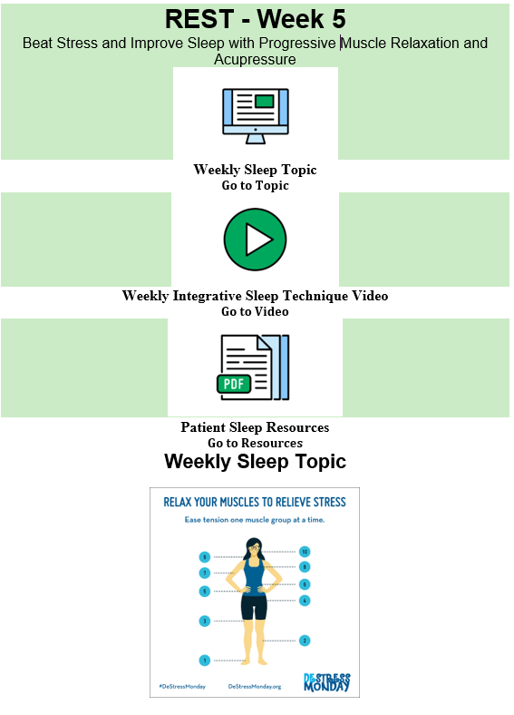
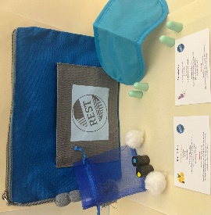
Program Content: REST
  Sleep Topic & Tips - Healthy Monday materials
    Sleep behavior and environment
  Integrative Health Sleep Videos
    Evidence-based Integrative Health Practices
  Patient Resources correlating to weekly sleep tip topic and integrative health practice
  Two optional, one-hour, in-person workshops to demonstrate integrative health techniques and offer guided practice
  Sleep kits containing items to support sleep

Slide 52
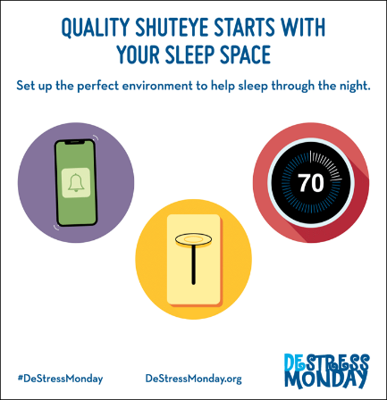
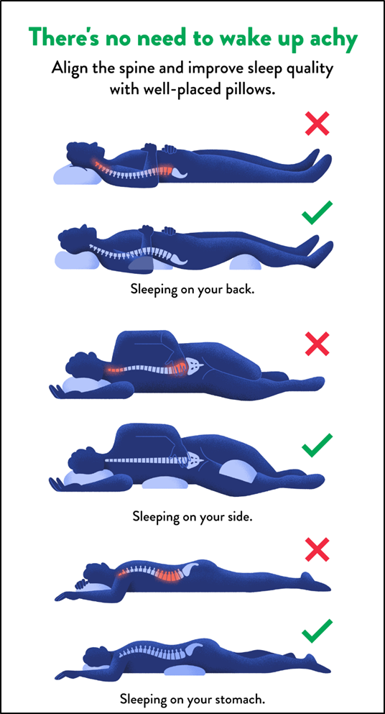
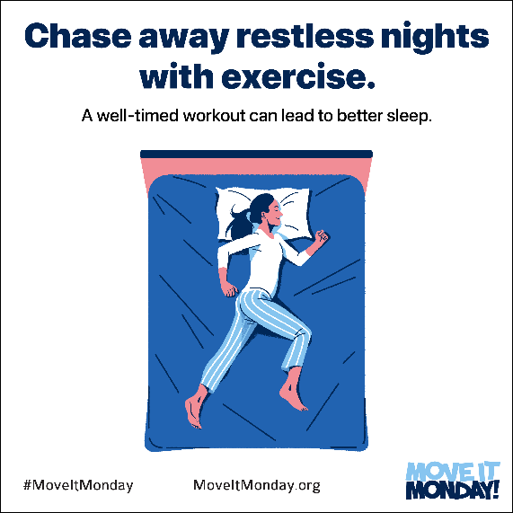
Results: REST
Demographics
Population: 166 pediatric trainees (residents and fellows)
12 participants enrolled
100% female
Represented post-graduate training years 1, 2, 3, and 5
Results
Sleep-related Impairment Score
  Pre-program mean score: 57.8 (out of 100), indicating higher than average impairment
  Post-program mean score: 53.7 (out of 100)
Perceived Stress
  Pre-program mean score: 6.63 (out of 16)
  Post-program mean score: 7 (out of 16)
All participants reported burnout symptoms
Engagement
Online REST Library traffic data indicate that all participants engaged in program materials
  66.7% viewed sleep tips
  Every video was watched at least once
  34.6% of patient resources were downloaded
Notes:
Burnout: burnout increased post-program, but there were only 3 respondents versus 8 respondents pre-program

Slide 53
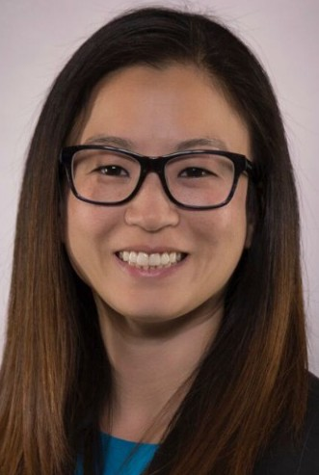
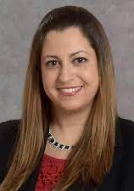
Lerner Fellowship Pilot Grant in Employee Wellness
~Department wide initiative cultivating those interested in research and clinical support advancing wellness (pilot projects, expansions of existing projects, or new projects)
~Awardees based on novelty, need, merit, and advancement of employee wellness
The HEROES Room: Healthy Environment to Recharge and Optimize Energy and Spirit
Objectives:
Provide a recharge room with a restorative environment
to reduce stress and mental fatigue and increase
employee productivity and well-being for the Pediatric Gastroenterology, Hepatology & Nutrition Division
Measuring Impact
Brief Psychological Well-Being Scale
1-item pre- and post-stress level question
Rating of element features of the HEROES Room
CALM-PT : Cultivating a Lifetime of Mindfulness for Pediatric Trainees
Objectives:
Improve trainee wellness through increasing an understanding of mindfulness and decreasing secondary traumatic stress and burnout
Provide mindfulness tools that can be used at bedside and in clinical practice
Measuring Impact
Mindfulness Attention Awareness Scale
Secondary Traumatic Stress Questions
Oldenburg Burnout Inventory
PI: Danielle Ahn, MD (Associate Professor of Pediatrics)
PI: Sivan Kinberg, MD (Assistant Professor of Pediatrics)
Notes:
Department wide initiative cultivating those interested in research and clinical support advancing wellness (pilot projects, expansions of existing projects, or new projects)
Awardees based on novelty, need, merit, and advancement of employee wellness

Slide 54

Barriers and Facilitators - Pilot Programs (2018 - 2021)
- Utilized Google Analytics Software to track traffic to program components
- Created new program content
- Developed a program inclusive of other well-being programs across the institution
- Filmed videos to increase access to experiential modules
- Open access during weeks of delivery
- Appoint Ambassadors to email their division, department, unit, or team listserv
6. Many participants may have previously received Healthy Monday Programming
1. Technical difficulties preventing ease of dissemination
5. Unclear knowledge of available well-being resources throughout the institution
2. Difficulty tracking participation engagement
(email firewall)
3. Not all work shifts aligned with program delivery (Monday email)
4. Pilot programs included in-person workshops that had low attendance due to conflicting clinic schedules

Slide 55

Lessons Learned and Solutions - IRB Programs (2022 – 2024)
- Set a study timeline for enrollment, intervention, and survey completion
- Shortened study timeline
- Pre- and post-surveys
- Create anonymous participant IDs at enrollment
- Require informed consent
- Explore the incorporation of incentives
- Incorporate REST into trainee’s regularly scheduled meetings
- Incorporate module into their education
1.Registration and survey completion were not required
2. Rolling enrollment and engagement
3. Inability to link pre- and post-surveys (no patient IDs)
4. Long recall time period
5. 24 weeks may have been too long to maintain engagement
1. Study duration (April – August 2023) overlapped with pediatric trainee graduation in July 2023
- Focus groups will be utilized to accrue more of a representative sample of the population
2. 100% of participants were female
Notes:
(insurance discounts, wellness days, retail and gym discounts, meal and grocery discounts, group classes)

Slide 56
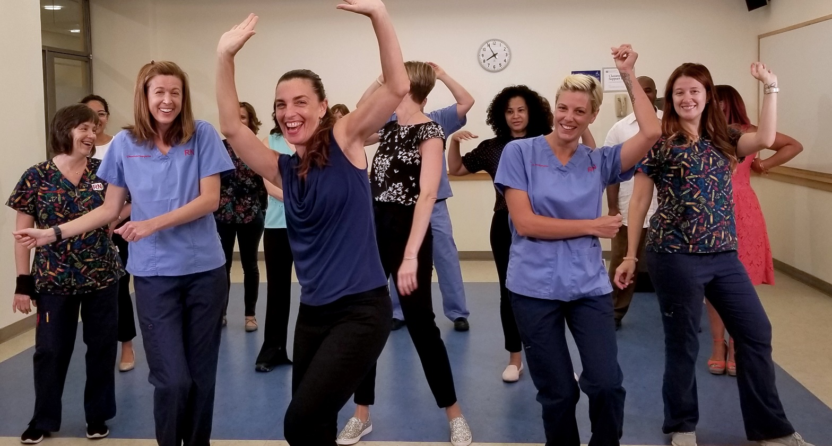
Thank you!!!

Slide 57

Branches of Wellness: Approaches for Cultivating Integrative Wellness Champions throughout the Hospital Community
Darah K. Salmaggi, MS
2025 International Congress on Integrative Medicine & Health
March 5th, 2025
Notes:
Introduction: DS

Slide 58

Branches of Wellness
Education, Training, Partnerships
The outgrowth of Integrative Wellness at NYU Langone Health
Implementation strategies: Identifying, training, and sustaining Wellness Champions
      Leveraging volunteers to expand the reach of Integrative Health programming
      Volunteer Impact Summary
Staff
Caregivers
Patients
Institutional &
Human Resources
Dept. of Integrative Health, Lerner Health Promotion
Notes:
Three branches of Integrative Health Wellness at NYU Langone Health: Integrative Health at NYU Langone is the intentional blending of E & W medicine in a coordinated way that honors the practices of our ancestors and ancient cultures with the validation of scientific evidence to support them today. At NYULH we delight in the opportunities to curate wellness resources for all members of our community: Staff, Patients and their caregivers.

Slide 59

The Critical Value of Cultivating Wellness
Burnout costs the U.S. health care system $4.6 billion a year, largely due to physician turnover and work-hour reductions with related cost to the organization is $500,000 to $1 million or more depending on the specialty. For the first time in four years, physician burnout reports are less than 50%.¹
Nurses are also significantly affected by burnout:
64% of nurses reported feeling “a great deal of stress”
Two-thirds of nurses were not receiving mental health support
1 in 10 nurses lacked the financial resources for mental health support
56% of nurses believed that mental health challenges were stigmatized in their profession²
Planting Seeds for the future by providing opportunities for wellness on the job:
Greatly decreases symptoms of occupational burnout³
Reduces anxiety⁴, depression⁵, loneliness⁶, stress⁷ and self-judgement⁷
Increases self-compassion⁸, feeling valued⁹, collegiality¹⁰, well-being engagement and resiliency⁷
Dept. of Integrative Health, Lerner Health Promotion
Notes:
So Why now more than ever? Well the good news is that for the 1st time 4 years physician burnout levels have dropped below 50% [ meaning (48.2%) of physicians reported experiencing at least one symptom of burnout] which makes our wellness efforts even more critical and is exactly why we must be steadfast with our shift toward Professionalizing Self-Care on the Job
Nurse’s of course are no exception and in fact have been the focal point of the majority of my department’s offerings. In Spring of ‘23 a collaborative research effort by the American Nurses Foundation and McKinsey surveyed more than 7,000 nurses to better understand mental health and wellbeing in the workforce. This survey revealed the following:
64% of nurses reported feeling “a great deal of stress”
Two-thirds of nurses were not receiving mental health support
1 in 10 nurses lacked the financial resources for mental health support
56% of nurses believed that mental health challenges were stigmatized in their profession
No secrets here right? We know that provider wellbeing is a pillar of quality care delivery models and it’s a competency for many integrative health providers and of course we have the research to back it showing that wellness on the job:
Greatly decreases symptoms of occupational burnout
Reduces anxiety, depression, loneliness
Increases self-compassion, feeling valued, collegiality, engagement and resiliency

Slide 60

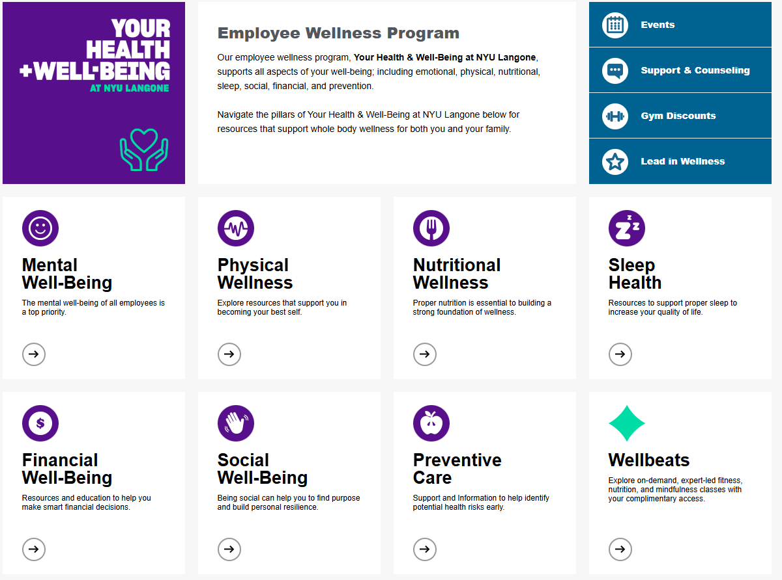
“Storms make trees take deeper roots”-Dolly Parton
Roots
Employee Wellness Programs
Second Victims Program
Corporate Counseling Associates
Team Lavender
Wellbeats
Schwartz Rounds
Stress First Aid
Langone Leadership Academy
Bright Horizons Backup Care
Dept. of Integrative Health, Lerner Health Promotion
Notes:
- It’s true that wind causes tree’s root systems to grow deeper, so in this way, wind strengthens the system, helping the foundation get stronger to support its structure so it can continue to expand. Similarly, in the past five years, there's been a global effort to define and cultivate wellness within organizations. And I would like to begin by very briefly sharing with you the many aspects of growth that support our wellness system.
-Widely acknowledged as “the cost of caring” its no secret that healthcare workers report higher rates of absences due to psychological distress and job burnout than workers in other sectors. NYU Langone has created a solid foundational structure that supports and fosters the organization’s culture of wellbeing is truly the root of our success. Here's a short list of some of our primary wellness resources that we have available to all of our 52k employees ( one of the largest healthcare systems in the NE)
These foundational roots enable the following growth and outcomes.
Wellbeats:On-Demand Fitness, Mindfulness, and Nutrition Built for Business​
Wellbeats Wellness, a product of LifeSpeak Inc., has over 1,200 on-demand classes f

Slide 61

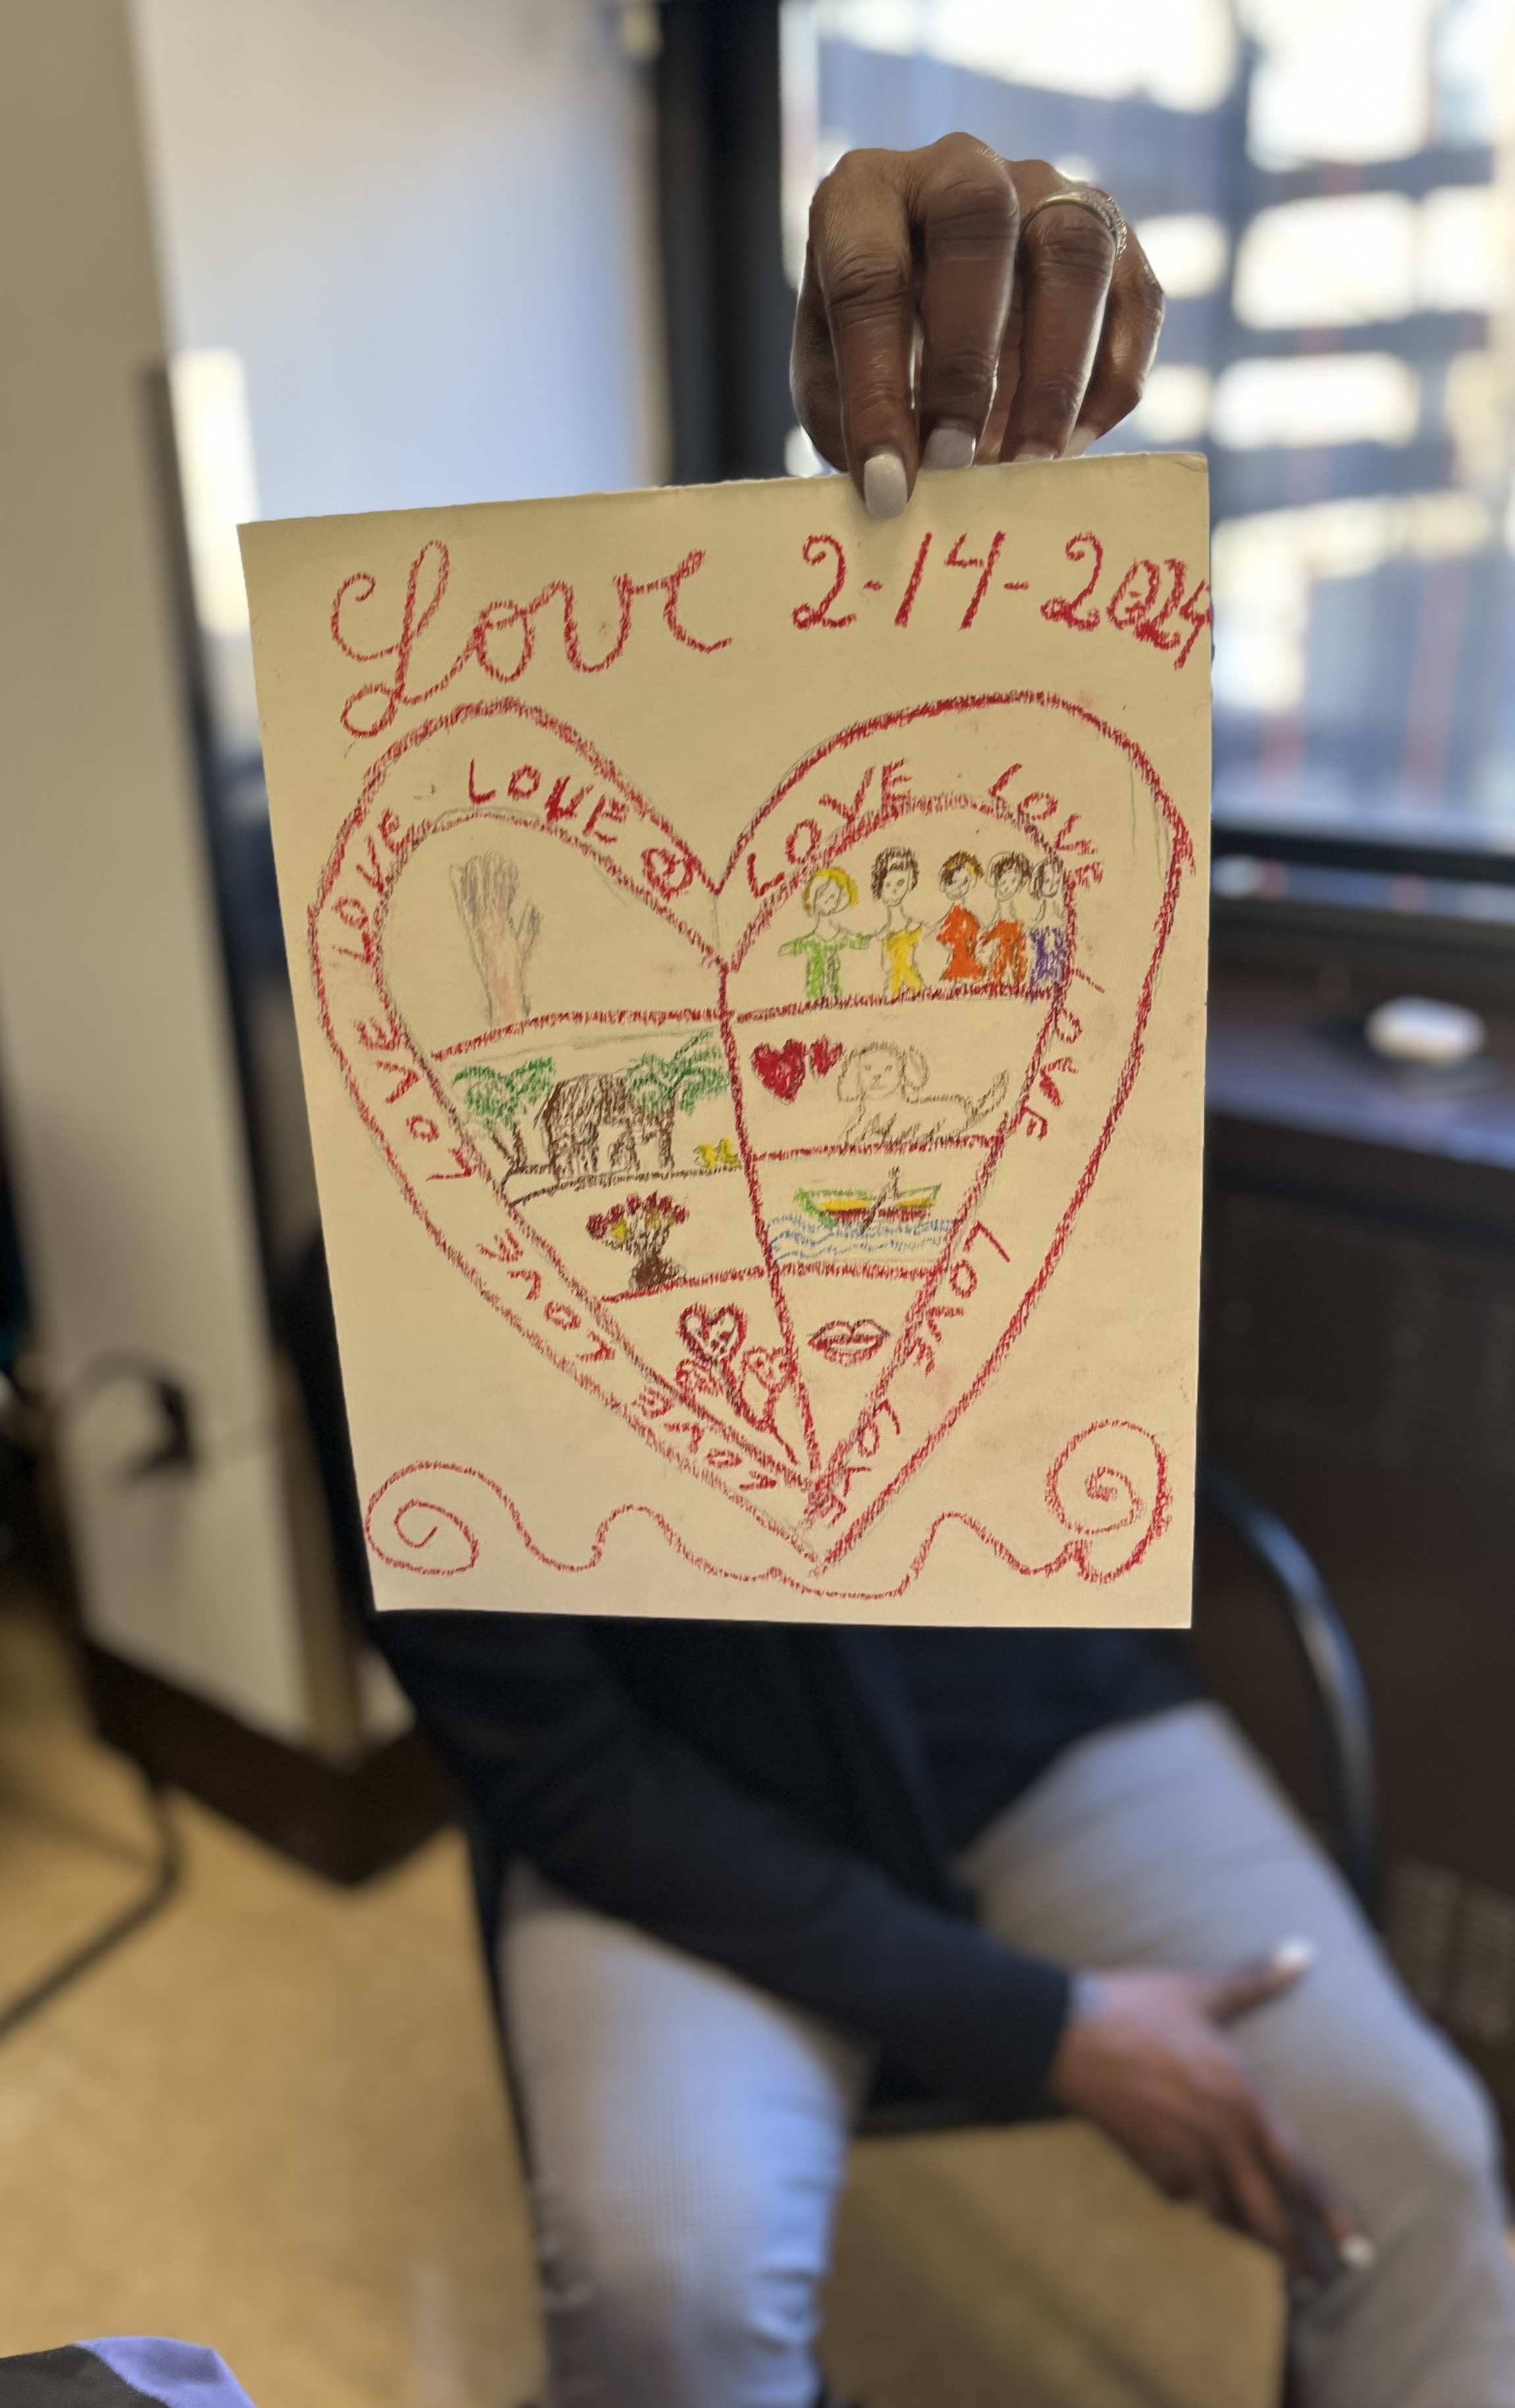

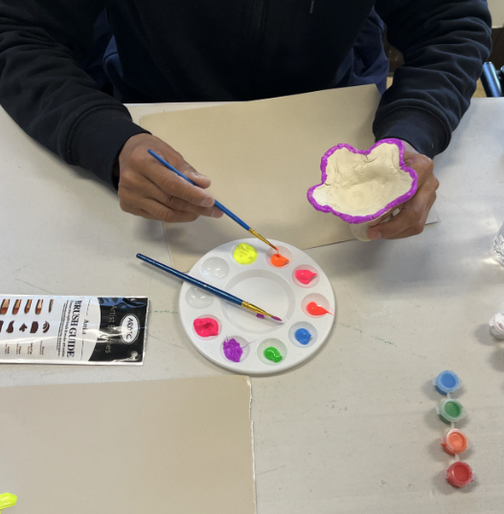
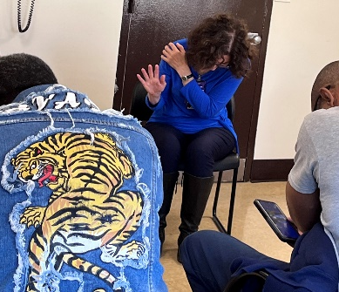
The Branch of Patient Wellness
Bedside Integrative Health Consults of Reiki, M-technique, Mindfulness, Meditation, Yoga, Poetry & Writing
Prepare for Surgery Heal Faster©
Trainings: Reiki & Mindbody Medicine©
Self-Care Resource Cart
Ambulatory site offerings of: Floral Design, Reiki, Art Therapy, Writing, Poetry, Reiki, Meditation, Yoga, Social Peer Gatherings
Volunteer led Reiki Treatments
Patients
Dept. of Integrative Health, Lerner Health Promotion
Notes:
The Department of Integrative Health and the Lerner Health promotion grant brought us significant opportunities to branch out our wellness programming to our reach our patients both in-house and at ambulatory locations. Considering the size of our health system, at this time we do not have capacity to expand each of these programs at each location but exisit as a case by case basis according to need, interest and funding sources.

Slide 62

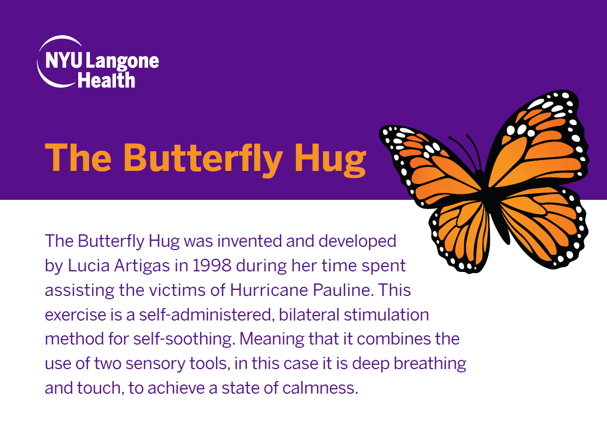
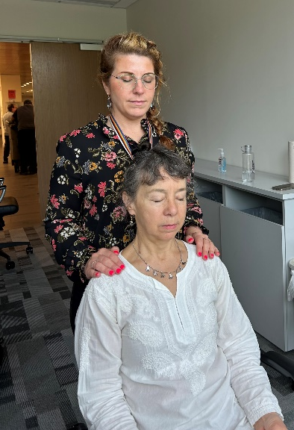
The Branch of Caregiver Wellness
Caregiver Reiki Sessions (Inpatient & Ambulatory)
Self-Care Resource Carts
Curated Energy Medicine and Reiki Trainings
Complementary care in OR waiting room
Caregivers
Dept. of Integrative Health, Lerner Health Promotion
Notes:
Its estimated that there are over 53 million unpaid caregivers in the United States right now with that number only increasing with the population of adults aged 85 and older projected to triple by 2050, there is an urgent need to address the increasing demands being placed on family caregivers. We try to acknowledge that stress and pressure while their loved ones are within our care. Whether they are sitting outside in a waiting room offered a cup of tea, a stress ball, a coloring book or Reiki treatment we want our caregivers to feel the appreciation we hold for them.

Slide 63
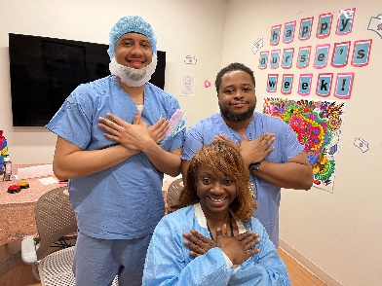

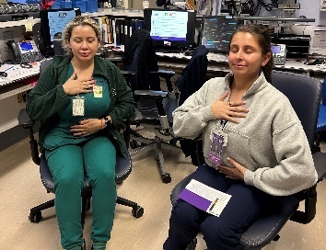
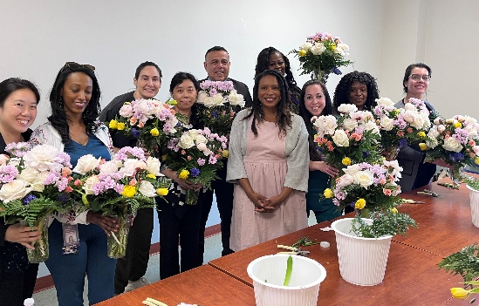
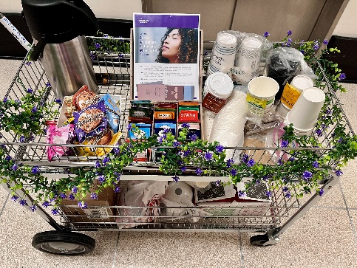
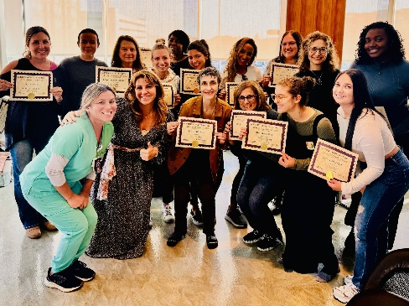
The Branch of Staff Wellness
Staff
Continued Education Trainings in: Reiki, Mindbody Medicine©, THRIVE©, Floral Design, Poetry, Writing, Art Therapy
Weekly Mindful Moments Meditation
Self-Care Resource Cart/ CALM Night Resources
Wellness Events, Lunch & Learns, Staff Retreats
Residency Wellness Projects
Integrative Health Fellowship Program
Acupuncture Clinic
Tool-kits: Aromatherapy, Virtual Reality, Tea for the Soul, Nursing Self-Care
Sound Healing, Reiki, Meditation, Yoga, Mindfulness*
_{*Volunteer-led}
Dept. of Integrative Health, Lerner Health Promotion
Notes:
We are committed to providing more wellness resources for our staff than any other branch of our organization, understanding that the well-being of our colleagues is the foundational for the well-being of everyone else. A large majority of the resources identified here are offered to all of our employees especially the trainings. The Resource I would like to highlight is our partnership with the Volunteers department. Truly it is through our collaboration efforts with these departments across the system that we are able to expand the reach of integrative health wellness programs that would not otherwise be funded. The programs serve as true benefit to all, as the volunteers are gaining authentic clinical experiences in their chosen practice and share their gratitude for the opportunities to engage in these acts altruism, the recipients ( staff, patient,caregivers) are getting the very unique opportunity and exposure to new tool, practices and resources that they would not have otherwise experienced. This gives everyone an opportunity to experience true holistic world class care.

Slide 64
Engagements for Volunteer-Led Integrative Health Programs
November 2023 – September 2024 (10 months)
Table 1. Participant Engagement (n=6,486)
Figure 1. Hours of Volunteer Effort across Campuses
544
Virtual
6,486
People Engaged in total
2,115
Brooklyn
20,412 Overall
7,417
Manhattan
10,336
Long Island
Brooklyn
Manhattan
Long Island
Virtual
Dept. of Integrative Health, Lerner Health Promotion
Notes:
This is just a tiny snap-shot of less than a year of just two of our volunteer led programs ( resource cart and reiki ) to give you an idea of the reach and impact
Leveraging our volunteers has allowed us to have the capacity to expand our programming reach by the thousands. Without sufficient funding to reach the 46k employees in our healthcare system we would be quite limited in our offerings. Engaging with professional integrative health practiticioners from our community allows us to bridge gaps and enhance our genuine connection to the communities we serve.

Slide 65


Building out the Structure
Truly understanding the need and feasibility for programming in a specific area is key
    Needs assessments
      e.g., assessing available resources, infrastructure, engagement, and wellbeing
Identifying the gardeners
    Champions & stakeholders
Investing your energy and efforts into building a strong root system first
    Identifying the right population(s) to start with
Preparing your soil with nutrients
    Educational in–service experiences for all to secure awareness and buy-in
Needs assessment/ identify barriers & facilitators
Curate evidence-based Integrative Health resources
Socialize the programming via a "Roll Out" wellness event
Request for Integrative Health support
Identify target population & Champions
Education & In-service
Dept. of Integrative Health, Lerner Health Promotion
Notes:
Using the analogy of planting, you need to first assess the ground area. What resources are naturally occurring/does the land have access to? Ie water, nutrients, good soil vs high heat, depleted dried out soil, lack of shade. For many of us, this translates to some form of needs assessment tool, then hearing from stakeholders and learning what has worked ( ie massage therapy exists now or once did ended during covid etc.). Its sort of dose defendant needs- if the email comes through requesting support we bring what we can, critical event in the dept CCA-and if that didn’t work we give something else.
If anyone here is a gardener you may very well know the frustrations of wanting to transform a corner of the property with new growth but find yourself competing with some stubbornly invasive species that are deeply rooted. Similar perspective here, your best to start with an area that is already conducive to the growth you're looking to expand. Carefully identifying which group the resources will most successfully “take seed” with ( ie the managers, the nurses, caregivers, patients) is really important. High adopters are obviously easier to work with. Starting with the right group really builds the cultural foundation, understanding of value, support and ultimately roots for the future outgrowth and expansion.
Once the right area is identified you choose which evidence based IH approach best suits the need of identified group. Pilot the resource and reassess impact ( surveys, verbal feedback, observations and QI)

Slide 66

Creating Cultures of Wellness through Organic Partnerships
    Human Resources
    Chief Nursing Officer
    Nurse Leaders/ Managers
    Nurse Manager Assistants, Preceptors
    Directors
    Former Students
    Spiritual & Pastoral Care
    Managers of Volunteer Departments
Dept. of Integrative Health, Lerner Health Promotion
Notes:
As we know, the landscape is always changing, the ongoing need to nurture, prune and reseed is only possibly through community efforts. Here are some of our partners that we rely on as solid arms to our branches.

Slide 67

Keys to Helping the Gardeners Grow
Professionalizing Self-Care
      A4 Project Scope
In-depth trainings
      Detailed toolkits
      Instructional videos
      Handouts with scripts
Keep Showing Up!
      Accessibility and trust-building
Wellness Day for EVERYONE
      Socializing the concept, getting first-hand experiences, answering questions
Leaders Stay in the Room
      Engage and demonstrate leadership's support
Normalizing Wellness
      360-degree support for nurturing self-care
Tracking Progress
      Follow reach and impact of respective programming
Dept. of Integrative Health, Lerner Health Promotion
Notes:
And now to the heart of this presentation I will share with you the key elements to our success with securing wellnesses champions and some tricks of the trade to gaining and maintain more of them.
Professionalizing SC: When the organization provides a resource solely for the intended benefit of its employees wellbeing, it is essentially making the workforce that they respect and expect you to take advantage of it. I often say since NYU is a world-class organization, we must have world-class self-care. When we receive a request for IH services our best practice is create an “A4 project scope“ which refers to it's a concise and focused outline of a project's goals, deliverables, boundaries, and constraints, all neatly contained within the dimensions of an A4 page. This scope clearly identifies the names of all the stakeholders, key players and in this way sets the tone for top-down buy-in. This also makes everyone accountable for its success or failure.
In-depth trainings: Providing champions with solid trainings including detailed toolkits with scripts, supplemental materials, live, role-playing and recorded demonstrations of the practices will insure the integrity and delivery of the techniques and will create confidence for the facilitators. Please stop by after this session for a post card that will lead you to our Resource Cart Tool-Kit to serve as an example for you.
Keep Showing Up! Especially when breaking into new spaces, keep demonstrating the work and building rapport After awhile your fans will start making themselves known especially when you miss a shift or don’t show one day, they’ll be the first to ask where you were!
Wellness Day for EVERYONE: Providing education for EVERYONE regardless if they will be recipients of the resource its great to have a “wellness day” and share with everyone from house keeping to the MD’s. This way the whole team can speak to the resource, promote it and first-hand understand its value
Leaders Stay in the Room: If theres one thing I request of the leaders when we first start a new initiative its- please stay in the room, lets show everyone your focused attention on making this initiative a success and who knows maybe you'll even feel more relaxed afterwards too?
Normalizing Wellness: finding ways to organically plant wellness, for example micro practices at huddles, wellness boards, shout-outs when you observe someone’s self-care, shared healthy lunches, nature outings, peer competitions for health goals, taking turns leading new wellness practices and asking others what's working for them
Tracking Progress: It's hard to know where you're going if you don’t have destination and you can't see how far you've come if you don't know where you started. Using self-surveys or group feedback helps track progress and also helps identify the hold ups and barriers.

Slide 68

Lessons Learned
Programming can be iterative
    Polling staff and taking feedback to heart re: obstacles to engaging with programming (e.g., night-shift staff access)
    Consider the most fertile soil to plant in first
    Early adopters
    Former Students/Trainee’s
    High Users
    Practical barriers
    Losing Leadership support
    Losing essential resources, such as dedicated time, funding, or support from a champion
    Not the right champions/volunteers
Dept. of Integrative Health, Lerner Health Promotion
Notes:
Although each area is unique, once you create a system that’s working somewhere you can likely recreate it with a few tweaks in a similar location
Polling staff and taking feedback to heart- Just because it sounds good doesn’t mean it will work ( ie ED CH if time allows)
Consider the most fertile soil to plant in first
Early adopters
Students/Trainee’s -former students from our trainings are often the ones who are reaching out to us looking for more support and those folks then organically fall into the roll of champion and are likely already being supported by their managers in these self-appointed roles.
High Users
Practical barriers
Losing Leadership support
Losing essential resources, such as dedicated time, funding, or support from a champion
Not the right champions- Screening your Volunteers for the space your working in to make sure their -We all know what it feels like to be “voleen-told” to do something right?

Slide 69

Questions?
We’d love to stay connected to you!
Darah K. Salmaggi, MS
Program Manager Department of Integrative Health
Lerner Health Promotion
Darah.Salmaggi@nyulangone.org
Cell: 347-387-6210
Kathleen DeMarco, NE-BC, CPHQ, PhD, RN
System Senior Director of Nursing Wellness and Resilience
System Senior Director Lerner Health Promotion
Kathleenann.Demarco@nyulangone.org
Cell: 917-363-5182
Dept. of Integrative Health, Lerner Health Promotion
Notes:
Happy to stick around and grab a coffee with anyone if youd like to connect

Slide 70
References:
¹Berg, S. (2024, July 2). Physician burnout rate drops below 50% for first time in 4 years. Fighting for Physicians. https://www.ama-assn.org/practice-management/physician-health/physician-burnout-rate-drops-below-50-first-time-4-years
² Berlin, G., Burns, F., Hanley, A., Herbig, B., Judge, K., & Murphy, M. (2023, November 6). Understanding and prioritizing nurses' mental health and well-being. American Nurses Foundation and McKinsey https://www.mckinsey.com/industries/healthcare/our-insights/understanding-and-prioritizing-nurses-mental-health-and-well-being
³ Cohen, C., Pignata, S., Bezak, E., Tie, M., & Childs, J. (2023). Workplace interventions to improve well-being and reduce burnout for nurses, physicians and allied healthcare
professionals: a systematic review. BMJ open, 13(6), e071203. https://doi.org/10.1136/bmjopen-2022-071203
⁴ Buchanan, T. M., Reilly, P. M., Vafides, C., & et al. (2018). Reducing anxiety and improving engagement in health care providers through an auricular acupuncture intervention. Dimensions of Critical Care Nursing, 37(2), 87–96. https://doi.org/10.1097/DCC.0000000000000288
⁵ Nigam, J. A. S., Barker, R. M., Cunningham, T. R., Swanson, N. G., & Chosewood, L. C. (2023). Vital signs: Health worker–perceived working conditions and symptoms of poor mental health — Quality of worklife survey, United States, 2018–2022. Morbidity and Mortality Weekly Report (MMWR), 72(44), 1197–1205. https://www.cdc.gov/mmwr/volumes/72/wr/mm7244e1.htm
⁶ Wood, R. E., Brown, R. E., & Kinser, P. A. (2022). The connection between loneliness and burnout in nurses: An integrative review. Applied Nursing Research, 66, 151609. https://doi.org/10.1016/j.apnr.2022.151609
⁷ Green, A. A., & Kinchen, E. V. (2021). The Effects of Mindfulness Meditation on Stress and Burnout in Nurses. Journal of holistic nursing : official journal of the American Holistic Nurses' Association, 39(4), 356–368. https://doi.org/10.1177/08980101211015818
⁸ Wei Z, Xia B, Jiang L, Zhu H, Li L, Wang L, Zhao J, Fan R, Wang P and Huang M (2024) Factors affecting occupational burnout in medical staff: a path analysis based on the job demands-resources perspective. Front. Psychiatry 15:1490171. doi: 10.3389/fpsyt.2024.149017 /w
ww.ncbi.nlm.nih.gov/books/NBK538330/
⁹Hall, A. J., Goodwin, V. A., Allchurch, L., et al. (2024). Feeling valued at work: A qualitative exploration of allied health profession support workers. BMC Health Services Research, 24, 1511. https://doi.org/10.1186/s12913-024-11879-z
¹⁰ Biouaraine, H., Ridoini, N., & Benabdelhadi, A. (2024). Employee wellbeing in the workplace: The role of HR in mental health and wellness initiatives. Zenodo, 4, 1160–1185. https://doi.org/10.5281/zenodo.13948367

Slide 71

Pathways for Every Learner:
Development of Integrative Health Education Opportunities Ranging from High School to Professionals
Fariza Alendy, MSW, MPH
3/5/2025
Department of Integrative Health
Lerner Health Promotion Program

Slide 72

Overview
Comprehensive approach to developing integrative health education opportunities
Programs spanning from high school to professional levels:
      High School Work Study Program
      Undergraduate Research Assistantships
      Federal Work-Study Partnerships
      Visiting Scholar Initiative
Mutual benefits, equity, and innovation

Slide 73
High School Work Study Program
Cristo Rey High School Partnership
Introduces integrative health concepts early, cultivating interest in nursing and holistic care
Students work one full day per week, earning up to 50% of their annual education costs
Health system responsible for very small share of cost; no direct cost to department
Transformative Impact
  100% of graduates since 2020 accepted into four-year colleges/universities
  77% of alumni graduated or on track to graduate from college
  Success rate 5 times the national average for students from similar economic backgrounds

Slide 74
Student Roles and Supervisor Responsibilities
Tasks and Limitations
Primarily administrative
      Distribute marketing materials for nursing wellness activities and events
      Support night shift initiative by packing supplies and coordinating with unit managers
Tasks limited to non-clinical areas due to age restrictions and institutional policies
Supervisor Responsibilities
Must be physically present on the students’ workday
Provide assignments, guidance, and feedback
Complete weekly emailed timecard/performance rating tool

Slide 75

Benefits and Considerations
Benefits
Bridges socioeconomic and cultural barriers, promoting diversity in healthcare education
Develops essential social, technical, and professional skills
Alleviates administrative burden for department
Considerations and Challenges
Be mindful of students' age and experience when setting expectations
Allow additional time for education on professional expectations
Institutional policies may restrict certain tasks (e.g., research-related activities)

Slide 76

Undergraduate Research Assistants
Strategic Solution to Expand Research Team’s Capacity
Small but dynamic research team; 2 individuals on payroll
      Associate Director of Research
      Per Diem Senior Data Analyst
  Limited resources necessitate creative staffing solutions
  Why Target Undergraduate Students?
  Familiarity with reading and critically appraising scientific articles
  Proficiency with specific software programs:
      Coding and data analysis
      Building questionnaires

Slide 77



A Mutually Beneficial Partnership
Students
Department
Both
  Gain invaluable experience and develop critical skills through Institutional Review Board protocol participation, potential co-authorship, and immersion in professional research environments.
  Expands capabilities and fosters innovation by leveraging the enthusiasm and fresh perspectives of motivated students, enhancing productivity and introducing new ideas to ongoing projects.
  Creates a mutually beneficial relationship that advances careers and knowledge in the field, building a pipeline of skilled researchers while fostering collaborative innovation.

Slide 78
Federal Work-Study Program Overview
Federal Work-Study (FWS) Program Overview
Provided part-time (up to 20 hours per week) job opportunities to eligible students
Approximately 3,400 institutions participate, serving nearly 600,000 students annually
Program aims to reduce reliance on loans and help students gain relevant work experience
Student Eligibility Criteria
Demonstrated financial need (via Free Application for Federal Student Aid)
Matriculated in a degree or applicable certificate program
Enrolled in at least 6 credits (half-time) per semester
Maintain Satisfactory Academic Progress

Slide 79
Why Develop Federal Work-Study Partnerships?
Why Develop FWS Partnerships?
Crucial for advancing integrative health work in resource-constrained settings
Provides access to skilled graduate students for research and program support
Offers cost-effective staffing solution – 25%/75% cost split
Aligns with public interest goals, focusing on well-being and health promotion
Considerations and Challenges
Securing institutional support, especially in unionized environments
Addressing potential concerns about displacement of existing roles
Allocating resources for program administration
Coordinating with multiple stakeholders (requires perseverance)

Slide 80
Visiting Scholar Overview and Responsibilities
Program Overview
Unique opportunity for doctoral-level student and early-career professionals to engage with esteemed faculty, researchers, and program developers
Duration: 6 months to 1 year
Aims to foster collaboration, innovation, and knowledge exchange in integrative health
Scholar Responsibilities
Support departmental research and programming efforts
Execute project-related tasks with academic rigor and professionalism
Present progress, updates, and outcomes to the department
Receive guidance from faculty and staff to refine approach and align with current trends

Slide 81
Importance and Implementation
Importance of the Initiative
Facilitates the sharing of diverse perspectives and expertise in integrative health
Accelerates research projects through additional skilled support
Identifies and nurtures potential future leaders in integrative health
Attracts international scholars, promoting cross-cultural understanding in healthcare
Provides high-level skills and knowledge without long-term financial commitments
Considerations for Implementation
Ensure clear communication of program expectations and limitations ‘
Develop a streamlined process for scholar integration and project assignment
Establish mentorship protocols to maximize scholar development and contribution

Slide 82
Cultivating the Future of Integrative Health
Key Outcomes and Impacts
Diverse programs create a robust pipeline of talent
Benefits across all levels:
      Early exposure and career opportunities for students
      Cost-effective staffing solutions for departments
      Knowledge exchange and innovation in the field
Next Steps
Expand partnerships and program reach
Continuously evaluate and improve initiatives
Advocate for increased support and resources

Slide 83


Questions?

Slide 84

Thank you!
Fariza Alendy, MSW, MPH
Program Director – Health Promotion
NYU Langone Health
Department of Nursing & Patient Care Services
530 First Avenue, Suite 3C - HC303B
New York, NY 10016
T 646-501-0255
M 646-983-8255
Fariza.Alendy@nyulangone.org

